Slide 1
Game analysis with SQL
Mentorness internship
Internship Project by Ahmed Mansour

Slide 2
Game analysis with SQL
Problem statement
The gaming industry relies on data to make informed decisions and enhance player experiences. In this project, I've analysed a game dataset to gain insights into player behaviours, gaming trends, and other crucial factors that influence game development and operations.

Slide 3
Game Analysis dataset
Data overview
We have two tables, Player and Level

Slide 4
Player table
`P_ID` Player ID
`Pname` Player Name
`L1_status` Level 1 Status
`L2_status` Level 2 Status
`L1_code` System generated Level 1 Code
`L2_code` System generated Level 2 Code

Slide 5
Level table
`P_ID` Player ID
`Dev_ID` Device ID
`start_time` Start Time
`stages_crossed` Stages Crossed
`level` Game Level
`difficulty` Difficulty Level
`kill_count` Kill Count
`headshots_count` Headshots Count
`score` Player Score
`lives_earned` Extra Lives Earned

Slide 6
I used SQL Server to query and analyse the data, and to answer specific questions from the dataset
WHAT will we do?

Slide 7
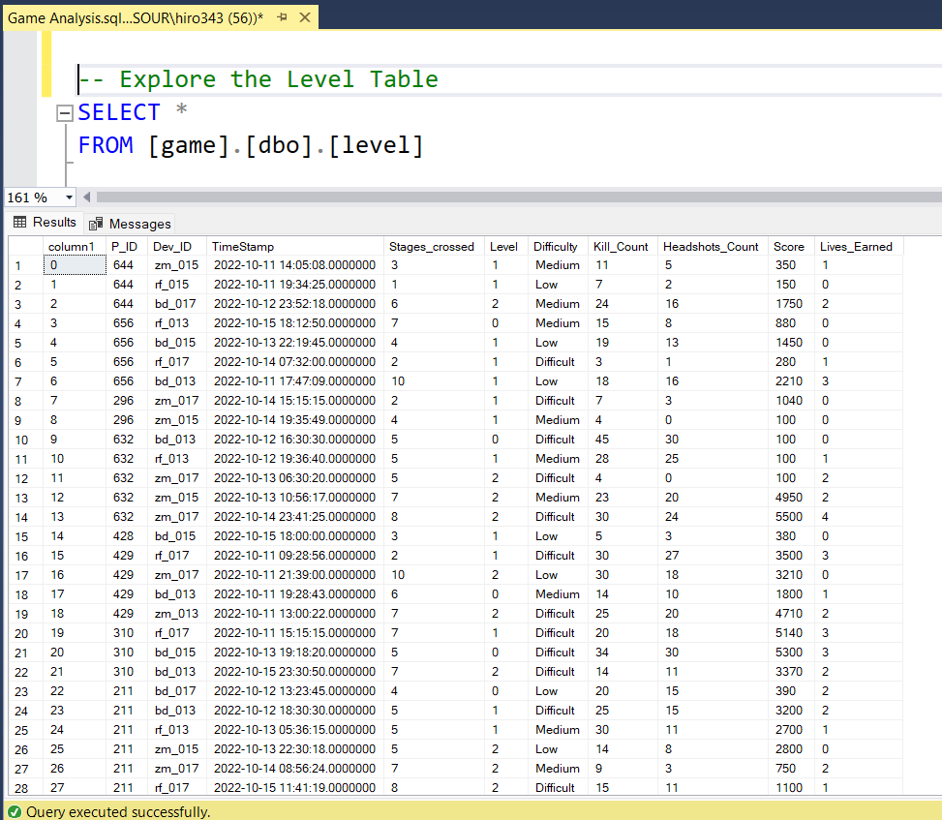
1- Explore the level dataset

Slide 8
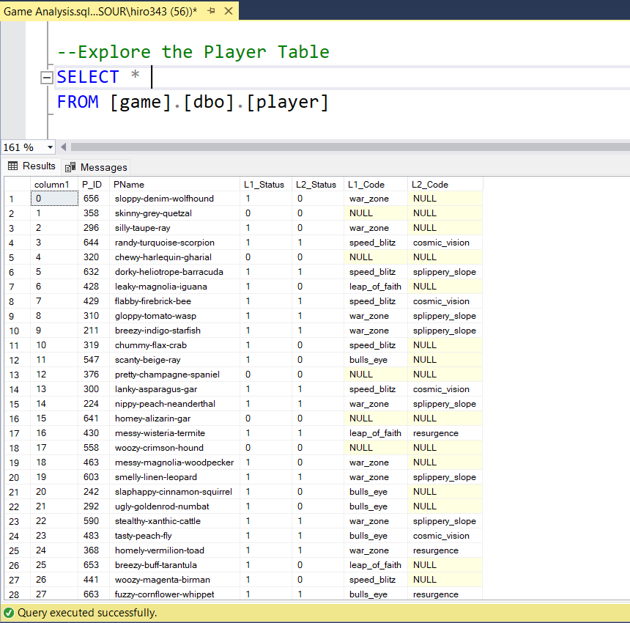
1- Explore the plyer dataset

Slide 9
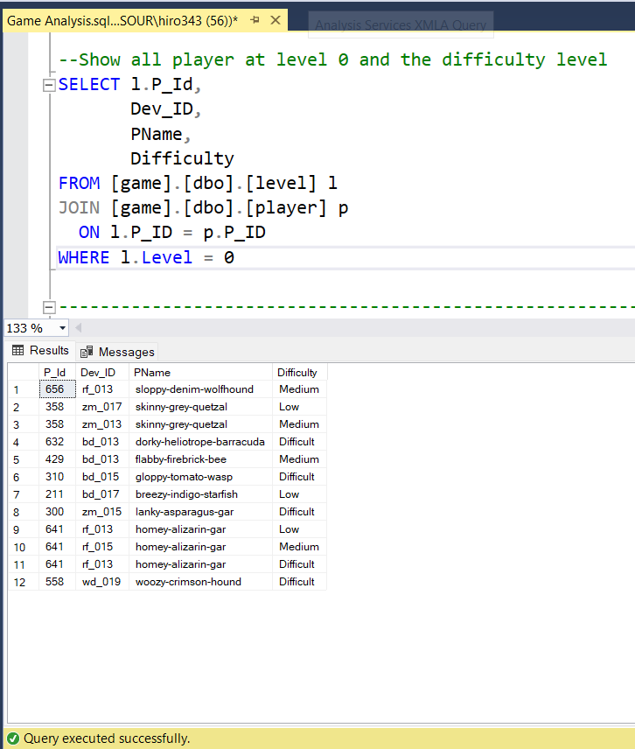
"Explore the dataset to gather information about all players at Level 0, including their Player ID, Device ID, Player Name, and Difficulty Level."

Slide 10
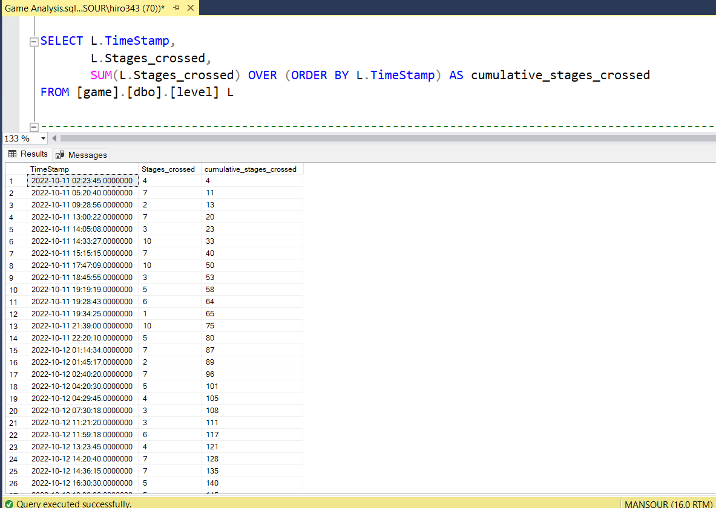
"Calculate the cumulative sum of stages crossed over time."

Slide 11
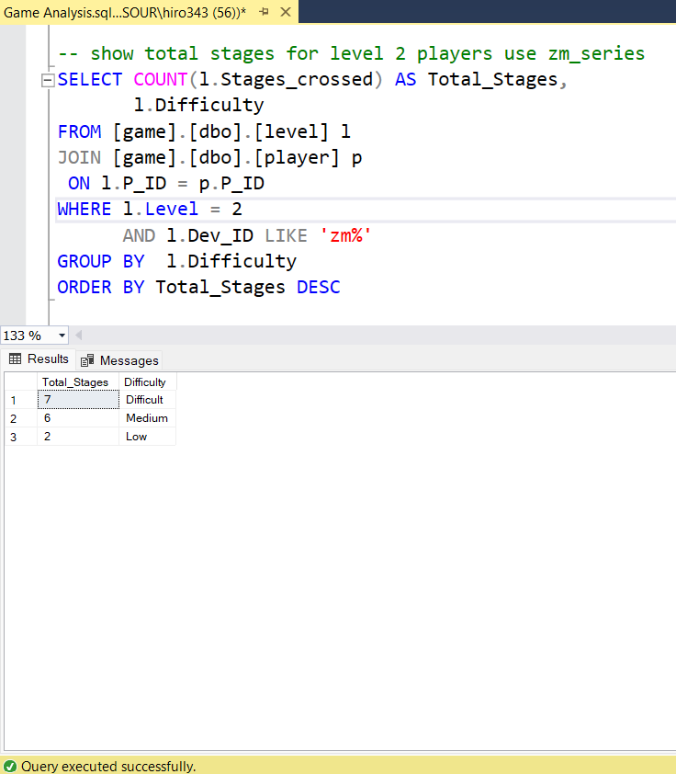
"Determine the total number of stages crossed at each difficulty level for Level 2, specifically for players using 'zm_series' devices. Present the results in descending order of total stages crossed."

Slide 12
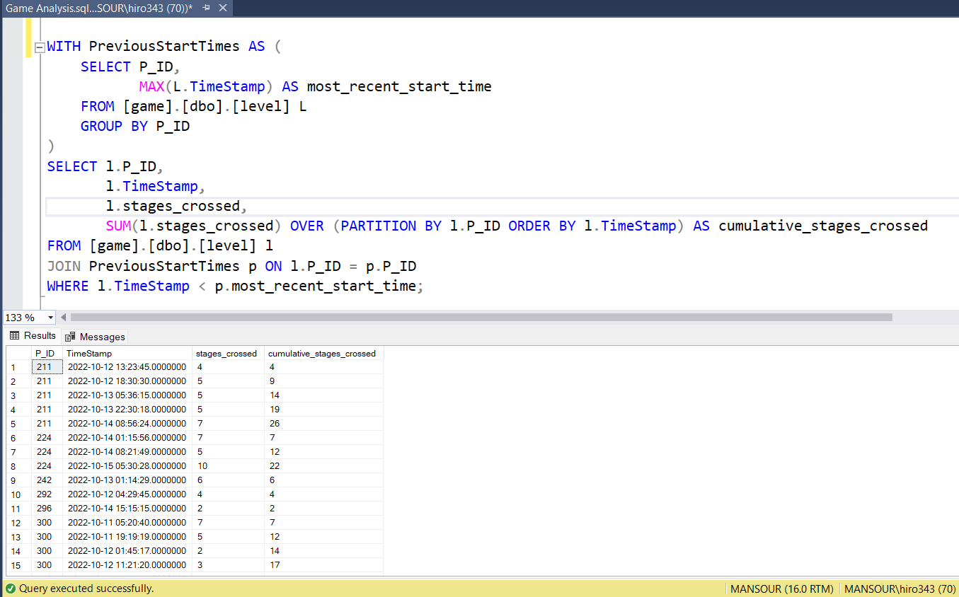
"Calculate the cumulative sum of stages crossed over time for each player, excluding the most recent start datetime."

Slide 13
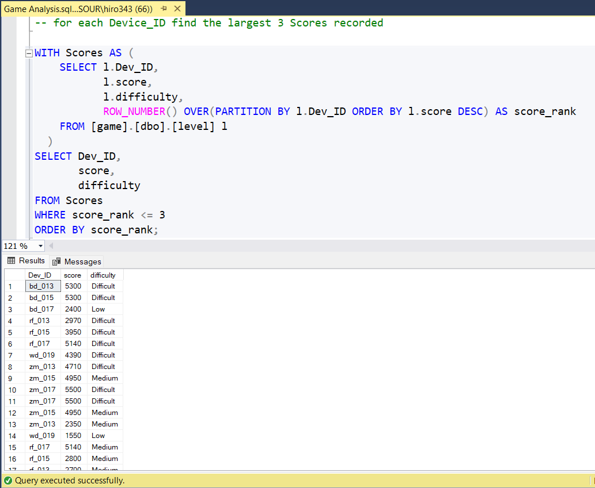
"Retrieve the top 3 scores achieved by players for each Device ID, ranking them in increasing order and displaying the associated difficulty level."

Slide 14
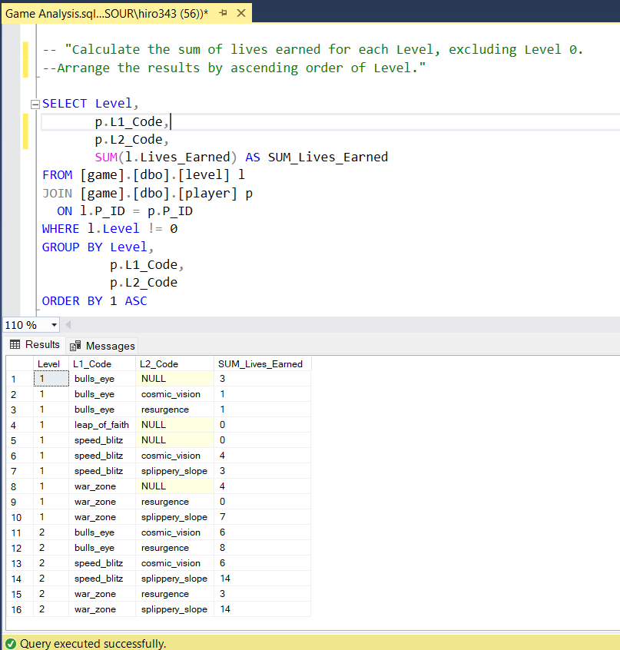
"Calculate the sum of lives earned for each Level, excluding Level 0. Arrange the results by ascending order of Level."

Slide 15
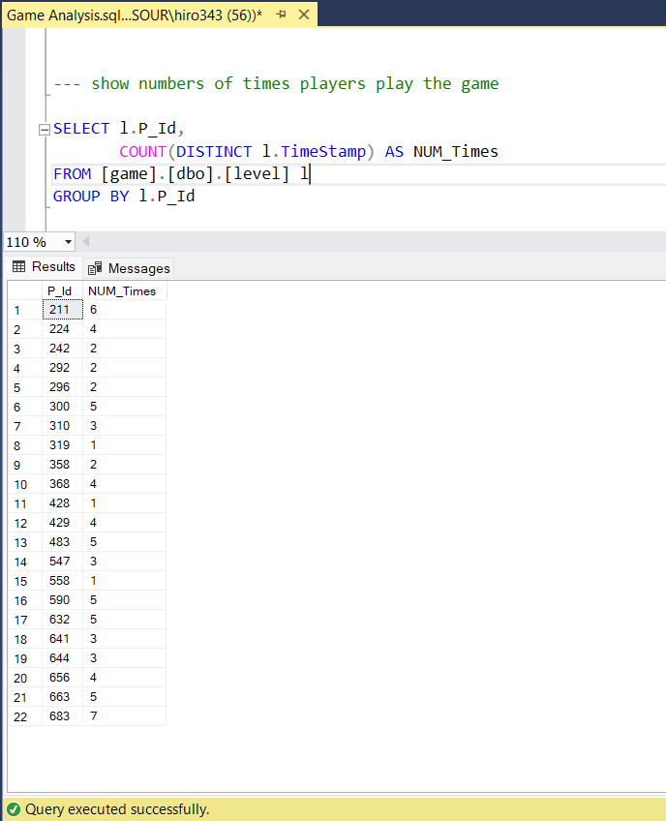
"Extract the Player ID and count the number of unique dates on which players have participated in games, considering only those who played on multiple days."

Slide 16
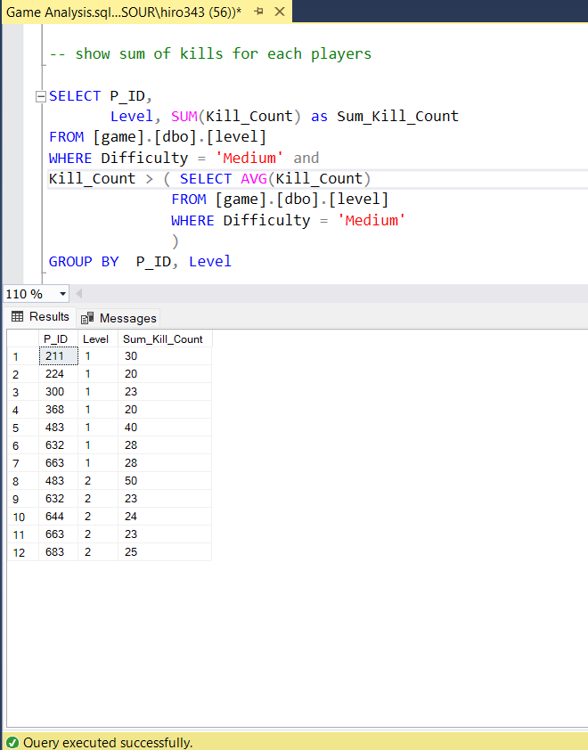
"Identify the sum of Kill Counts for players at each level, considering only counts greater than the average Kill Count for Medium difficulty."

Slide 17
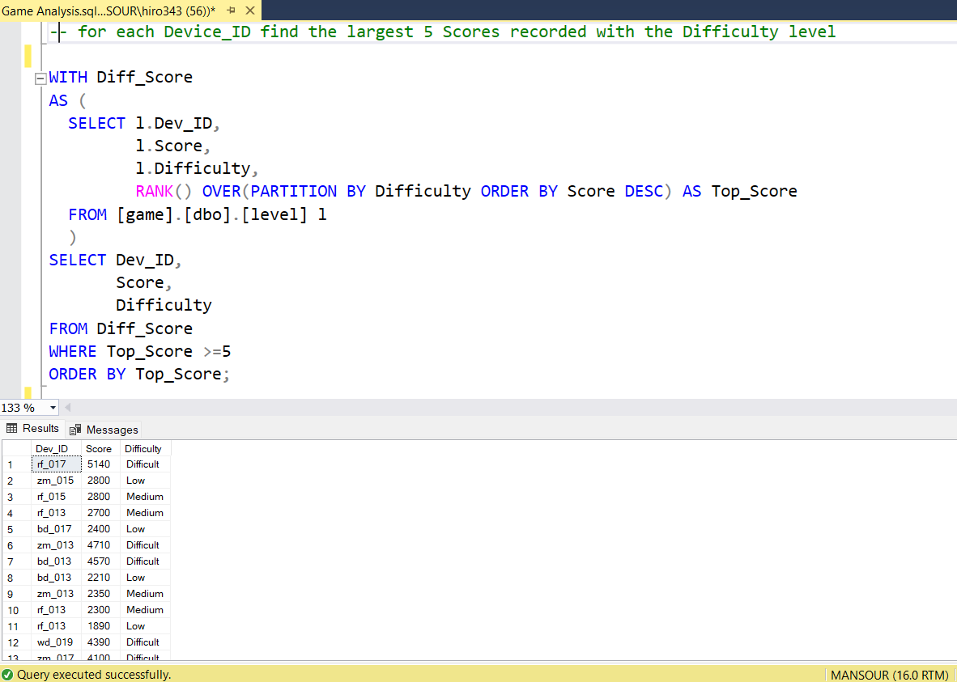
"Find the top 5 scores achieved for each difficulty level, ranking them in increasing order and displaying the associated Device ID."

Slide 18
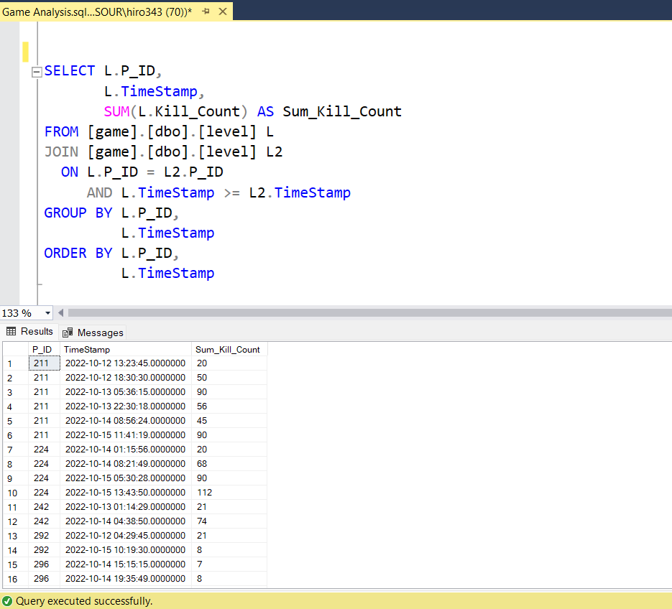
Calculate the cumulative sum of kill counts for each player and date

Slide 19
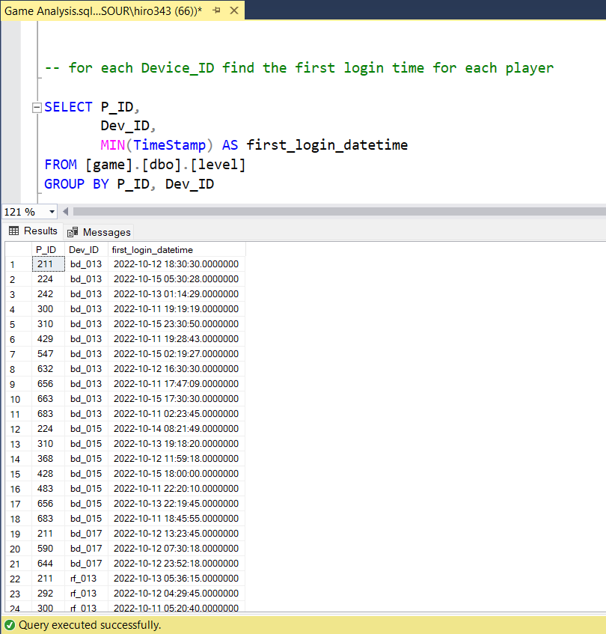
"Find the datetime of the first login for each Device ID."

Slide 20
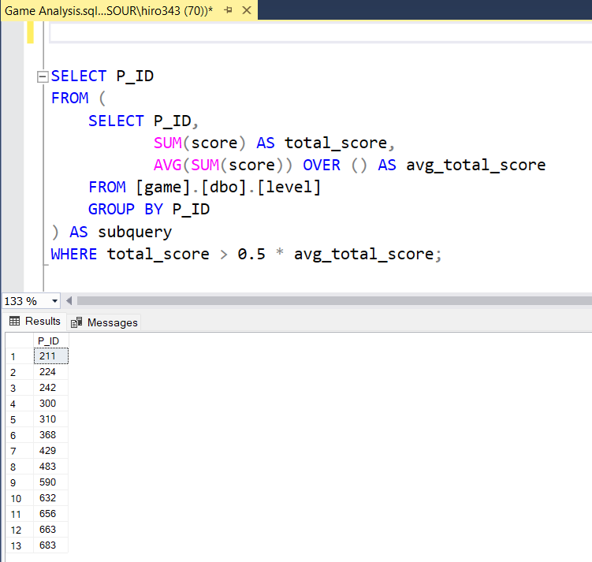
Find players who scored more than 50% of the avg score scored by sum of -- scores for each player

Slide 21

Conclusion
"By leveraging data-driven approaches, we can better understand player engagement, optimize game mechanics, and ultimately enhance the overall gaming experience for our audience."
“the analysis of the game dataset has provided valuable insights into player behaviours, preferences, and gaming trends, which can inform future game development strategies."
"Moving forward, continued analysis and utilization of game data will be essential in driving innovation, refining gameplay experiences, and maintaining a competitive edge in the dynamic gaming industry."

Slide 22

QUESTIONS

Slide 23
Thanks

